Slide 1
MOAT ACADEMY
WEB APPLICATION DEVELOPMENT TRAINING
Colors, Fonts , External CSS – Day2

Slide 2
GROUPINGS AND MORE
Specific element
Element within another
Grouping of Tags

Slide 3
Specific class Element
Helps you specify specific HTML elements that should be affected by a class.
In the example below, only <p> elements with class="center" will be center-aligned:
p.center {
text-align: center;
color: red;
}
Note that there is no space between the p tag and the class (.center)

Slide 4
The DOM and “Cascading” Idea
The Document Object Model (DOM) – a representation of the document in the computer memory.
When a browser displays a document, it combines the document's content with its style information and displays the contents of the DOM
A DOM has a tree-like structure. Each element, attribute and piece of text in the markup language becomes a DOM node in the tree structure.
The nodes are defined by their relationship to other DOM nodes. Some elements are parents of child nodes, and child nodes have siblings.

Slide 5
The DOM and “Cascading” Idea
<head>
  <title></title>
  <meta>
  <meta>
</head>
<body>
  <h1>Welcome</h1>
  <p><a href=‘#’>This is an example of:</a></p>
  <ul>
      <li>Cascading</li>
      <li>is my Style</li>
      <li>Sheets</li>
  </ul>
</body>
The next slide shows the above DOM structure,
Notes:
A tree-like structure containing each of the tags and their contents

Slide 6
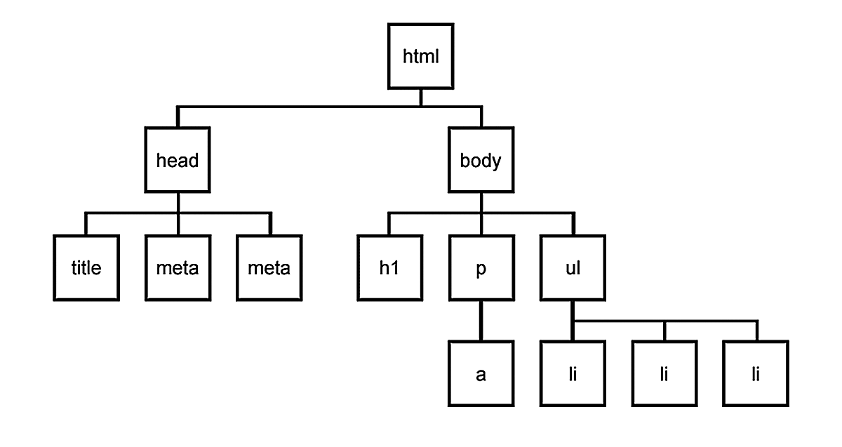
The DOM and “Cascading” Idea
implication of the DOM is that certain styles can be applied to the child(ren) via the parent. A color set on <ul> will affect all the <li>.
*Setting color for <a> tag has to be done on the <a> tag itself.

Slide 7
The DOM and “Cascading” Idea
<head>
  <title></title>
  <meta>
</head>
<body>
  <ul>
      <li>Cascading</li>
      <li>is my <span>Style</span></li>
      <li>Sheets</li>
  </ul>
</body>
QUIZ: how will you represent the above in a DOM?,Can you style the span using the DOM structure?
SOLUTION: See the notes
Notes:
ul li span{color:red}
A tree-like structure containing each of the tags and their contents
Note the space

Slide 8
Specific class Element
Hint- you are giving a total description of the tag, naturally you want to pause as you describe… see the pause as space
The <a> tag, inside <li> inside <ul> tag. Stating this will ensure that only the specific <a> tag mentioned will be affected by the rule
ul li a{
text-align: center;
color: red;
}

Slide 9
Grouping Selectors
You can minimize your codes by grouping elements that have similar definitions
Consider:
h1, h2 and p tags that are center-aligned, text color of red and font size of 12px, rather than specifying the same rules for each of the elements, you can group them.
To group selectors, separate each selector with a comma.
h1,h2,p{
text-align:center;
color:red;
font-size:12px;
}
Notes:
Formular: you are saying “h1 and h2 and p should obey these rules”

Slide 10
Exercise
Change the color of all <p> and <h1> elements, to "red". Group the selectors to minimize code.
Try out different styles with the anchor tag

Slide 11
More Rules for the unordered list
Using custom image as bullets

Slide 12

As seen on Moat Academy Website

Slide 13
The List-style Properties
The list-style shorthand property sets all the list properties in one declaration.
The properties that can be set, are (in order):
  list-style-type: disc; /* disc | square | circle | none */
  list-style-position: inside; /* outside */
  list-style-image.
All the above can be combined in a shorthand as follows:
list-style: url("images/arrow.png") inside

Slide 14
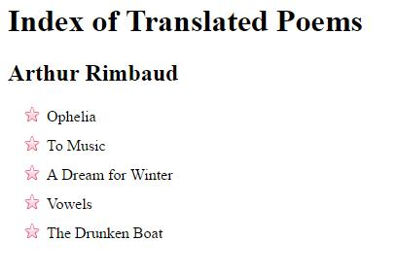
Exercise: Replicate the following (using the image given)

Slide 15
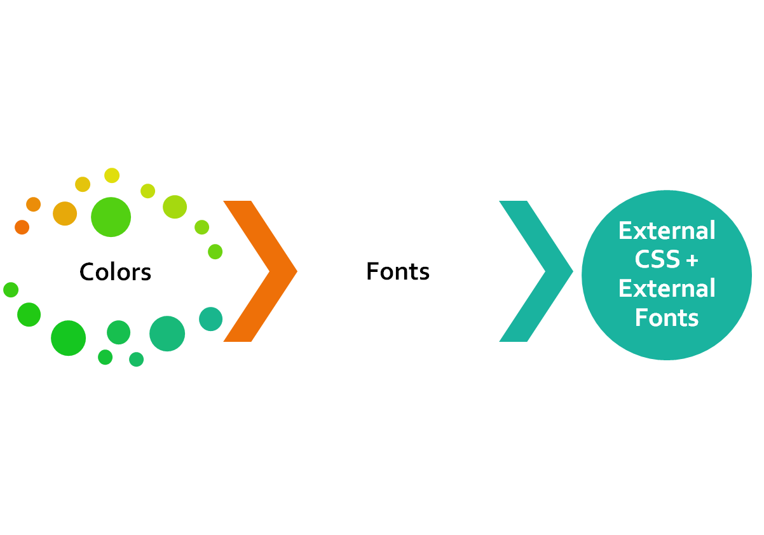
CLASS
OUTLINE

Slide 16
CSS COLORS
Colors are specified using predefined color names, or RGB, HEX, RGBA values.

Slide 17
COLOR NAMES
In HTML, a color can be specified by using a color name:
Tomato, Orange, DodgerBlue, MediumSeaGreen, Gray,SlateBlue, Violet, LightGray
HTML Supports 140 standard color names.

Slide 18
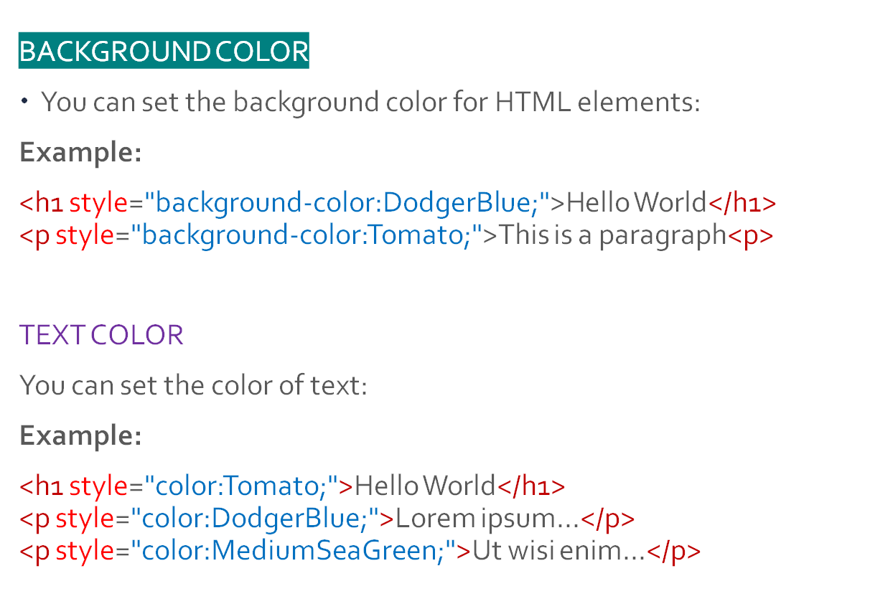
USE CASES

Slide 19
Quiz
Create a HTML page
How would you specify that all paragraph elements <p> on the page be written in red?

Slide 20
USE CASES
BORDER COLOR
You can set the color of borders:
Example:
<h1 style="border:2px solid Tomato;">Hello World</h1>
<h1 style="border:2px solid DodgerBlue;">Hello World</h1>
<h1 style="border:2px solid Violet;">Hello World</h1>

Slide 21
COLOR VALUES
Default font color is Black
In HTML, colors can also be specified using RGB values, HEX values, HSL values, RGBA values, and HSLA values:
Example:
Same as color name "Tomato":
rgb(255, 99, 71)
#ff6347
<h1 style="background-color:rgb(255, 99, 71);">...</h1>
<h1 style="background-color:#ff6347;">...</h1>
Same as color name "Tomato", but 50% transparent:
rgba(255, 99, 71, 0.5)
<h1 style="background-color:rgb(255, 99, 71,0.5);">...</h1>

Slide 22
RGB VALUES
In HTML, a color can be specified as an RGB value, using this formula:
rgb(red, green, blue)
Each parameter (red, green, and blue) defines the intensity of the color between 0 and 255.
Each of the rgb can have between 0 – 255 value any thing outside this range is syntactically wrong
For example, rgb(255, 0, 0) is displayed as red, because red is set to its highest value (255) and the others are set to 0.

Slide 23
QUIZ
As you manipulate the numbers, they give you different shades of the colour
What do you think rgb(255,100,0) will give us? – A colour close to?

Slide 24
RGBA VALUES
RGBA color values are an extension of RGB color values with an alpha channel - which specifies the opacity for a color.
An RGBA color value is specified with:
rgba(red, green, blue, alpha)
The alpha parameter is a number between 0.0 (fully transparent) and 1.0 (not transparent at all):
Example:
rgba(255, 99, 71, 0.5)
<h1 style="background-color:rgb(255, 99, 71,0.5);">...</h1>

Slide 25
HEX VALUES
In HTML, a color can be specified using a hexadecimal value in the form:
#rrggbb or #rgb (if each of rgb are the same)
Where rr (red), gg (green) and bb (blue) are hexadecimal values between 00 and ff (same as decimal 0-255).
For example, #ff0000 is displayed as red, because red is set to its highest value (ff) and the others are set to the lowest value (00).

Slide 26
Do we need trial and errors in choosing colours?
You can use tools such as MS Paints, Corel Draw to get the values
Type color picker on google to get the color chart
You can also use certain browser plugins like Mozilla Firefox Color Picker to get the codes
A good sense of color mix is important for a designer
Useful : https://coolors.co/app

Slide 27
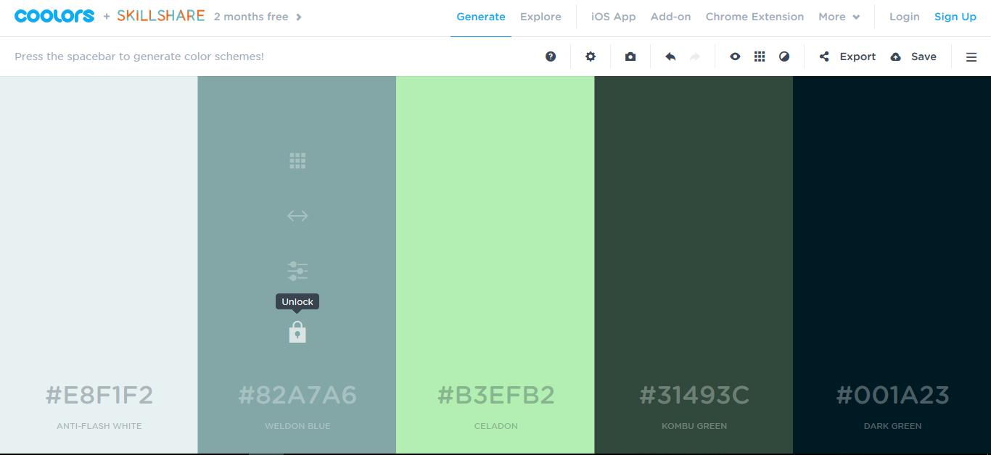
Getting colour combination from coolors.co
Notes:
Note on https://coolors.co/app:
Keep pressing the space bar for different color mix
There are a range of options when you hover on the columns, eg:
You can lock a color in a particular column by clicking on the padlock icon so that the app can generate other colors that can be combined with the one you locked
You can edit any of the color value if you have your own custom design (say a customer already tells you the shade he wants)
When you are done, you can export it for your reference

Slide 28
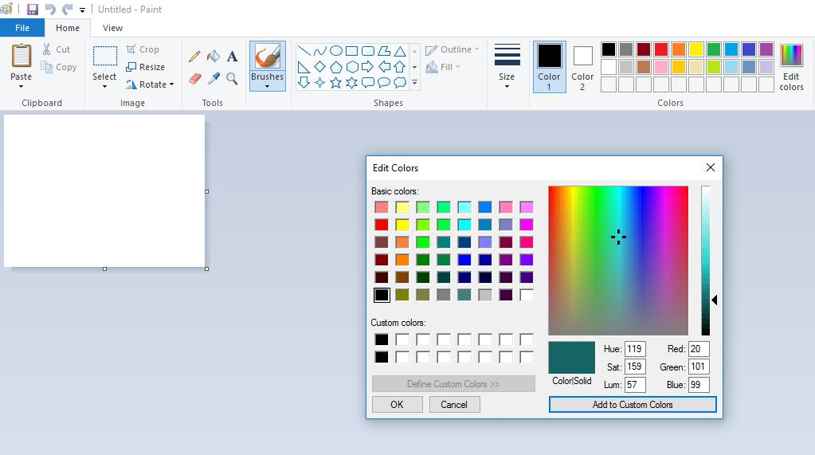
rgb value from MS Paint
Notes:
Create a new document
Click on the”Edit Color” at the top right to dispay the color pallete, as you select diferent shades, the corresponding rgb is generated in the box as shown

Slide 29
CSS FONTS
The CSS font properties define the font family, boldness, size, and the style of a text.

Slide 30
CSS FONT FAMILIES
Font family could be classified as :
generic family - a group of font families with a similar look (like "Serif" or "Monospace")
font family - a specific font family (like "Times New Roman" or "Arial")
Generic family | Font family | Description
Serif | Times New Roman Georgia | Serif fonts have small lines at the ends on some characters
Sans-serif | Arial Verdana | "Sans" means without - these fonts do not have the lines at the ends of characters
M o n o s p a c e | Courier New Lucida Console | All monospace characters have the same width
Cursive (joint/running handwriting) | Water Brush, Lucida Calligraphy | Symbols of the text are written in a flowing manner
Note: On computer screens, sans-serif fonts are considered easier to read than serif fonts.

Slide 31
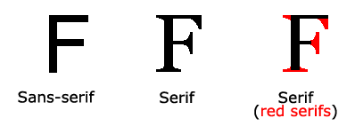
Generic Font Family Explained
Notes:
Sans serif – those without curves
Serif – those with curves

Slide 32
FONT-FAMILY
The font family of a text is set with the font-family property.
The font-family property should hold several font names as a "fallback" system. If the browser does not support the first font, it tries the next font, and so on.
Start with the font you want, and end with a generic family, to let the browser pick a similar font in the generic family, if no other fonts are available.
Note: If the name of a font family is more than one word, it must be in quotation marks, like: "Times New Roman".
More than one font family is specified in a comma-separated list:
Example:
p {
font-family: "Times New Roman", Times, serif;
}

Slide 33
TIPS
It is usually a best practise to end the font-family specification / list with the generic name. eg
font-family: arial, corbel, san-serif
In the above, you are telling the browser “I want to use arial, but if arial is not available on this computer.. Use corbel, if both are not available… just use any font that belongs to the family of san-serif”
Remember san-serif is no curves, so also arial and corbel.

Slide 34
QUIZ*: What is wrong with this specification?
Font-family: “Times New Romans”, Times, sans-serif;
Notes:
Answer, Times New Roman and Times are both serif, yet the user is saying if there is no Times New Roman, use any one of the family no-curve! Whereas Times News Roman is a serif
It means that the website will look so much different when checked on two systems; one with times news roman, the other when there is no times new romans

Slide 35
FONT-STYLE
The font-style property is mostly used to specify italic text.
This property has three values:
normal - The text is shown normally
italic - The text is shown in italics
oblique - The text is "leaning" (oblique is very similar to italic, but less supported)
Example:
p {
font-style: normal;
}
p {
font-style: italic;
}
p {
font-style: oblique;
}

Slide 36
FONT-SIZE
The font-size property sets the size of the text.
Being able to manage the text size is important in web design. However, you should not use font size adjustments to make paragraphs look like headings, or headings look like paragraphs.
Always use the proper HTML tags, like <h1> - <h6> for headings and <p> for paragraphs.
The font-size value can be an absolute, or relative size.
If you do not specify a font size, the default size for normal text, like paragraphs, is 16px in most browsers

Slide 37
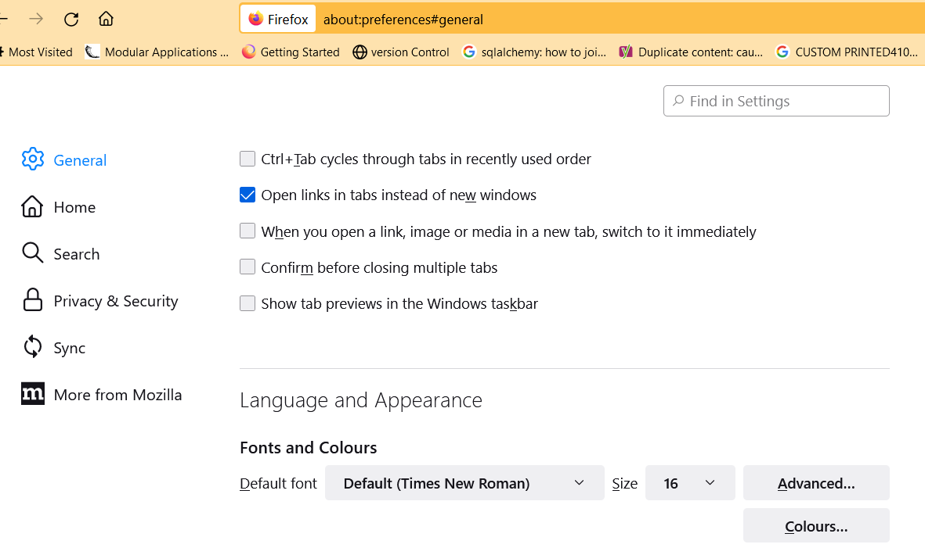
Mozilla Firefox Settings

Slide 38
FONT-SIZE WITH PX
h1 {
font-size: 40px;
}
h2 {
font-size: 30px;
}
p {
font-size: 14px;
}
Setting the text size with pixels gives you full control over the text size:
When you use px, the font size remains the same even if you adjust the font-size from the browser settings.
Note: If a website designer uses pixels, visitors to the website can still use the zoom tool to resize the entire page.

Slide 39
RELATIVE FONT-SIZE WITH EM (element)
The em size unit is recommended by the W3C.
1em is equal to the current browser font size. The default text size in browsers is 16px. So, the default size of 1em is 16px.
Can be specified in decimal eg 0.75em
The size can be calculated from pixels to em using this formula: pixels/16=em
If the developer uses em unit and visitors to the site adjust their default browser font size, the website texts would also grow accordingly.
h1 {
font-size: 2.5em; /* 40px/16=2.5em */
}
h2 {
font-size: 1.875em; /* 30px/16=1.875em */
}
p {
font-size: 0.875em; /* 14px/16=0.875em */
}

Slide 40
RESPONSIVE FONT-SIZE
The text size can be set with a vw unit, which means the "viewport width".
<h1 style="font-size:10vw">Hello World</h1>
Viewport is the browser window size. 1vw = 1% of viewport width. If the viewport is 50cm wide, 1vw is 0.5cm.

Slide 41
FONT-WEIGHT
The font-weight property specifies the weight of a font:
Syntax:
font-weight: normal|bold|bolder|lighter|number|initial|inherit;
Example:
p.normal {
font-weight: normal;
}
p.thick {
font-weight: bold;
}

Slide 42
EXERCISE
Set the font family for the page to "Courier New", and the font family for <h1> to "Verdana".
Show <p> elements as "italic" text.
Set the font size for the page to "20px", and the font size for <h1> to "3em“
Show <p> elements as "bold" text.
With the font property: Set the <p> to "italic", "20px" and "Verdana".
<!DOCTYPE html>
<html>
<head>
<style>
</style>
</head>
<body>
<h1>This is a Heading</h1>
<p>This is a paragraph.</p>
<p>This is another paragraph.</p>
</body>
</html>

Slide 43

Other CSS Font Properties
text-transform ( uppercase, lowercase, capitalize)
text-decoration (none to remove underline)
As seen on Moat Academy website, the 3 anchor tags are all in capital letter, and not underlined, only the first is brown while others are black, they are sans-serif

Slide 44
EXTERNAL CSS
External style sheets are created in separate documents with a .css extension.
An external style sheet is simply a listing of CSS rules. It cannot contain HTML tags.
The <link> tag, which goes in the head of an HTML page, is used to link to an external style sheet.
There is no limit to the number of external style sheets a single HTML page can use.
Syntax:
<link href=‘filelocation’ rel=‘stylesheet’ type=‘text/css’>
Example
<link href=‘style.css’ rel=‘stylesheet’ type=‘text/css’>

Slide 45
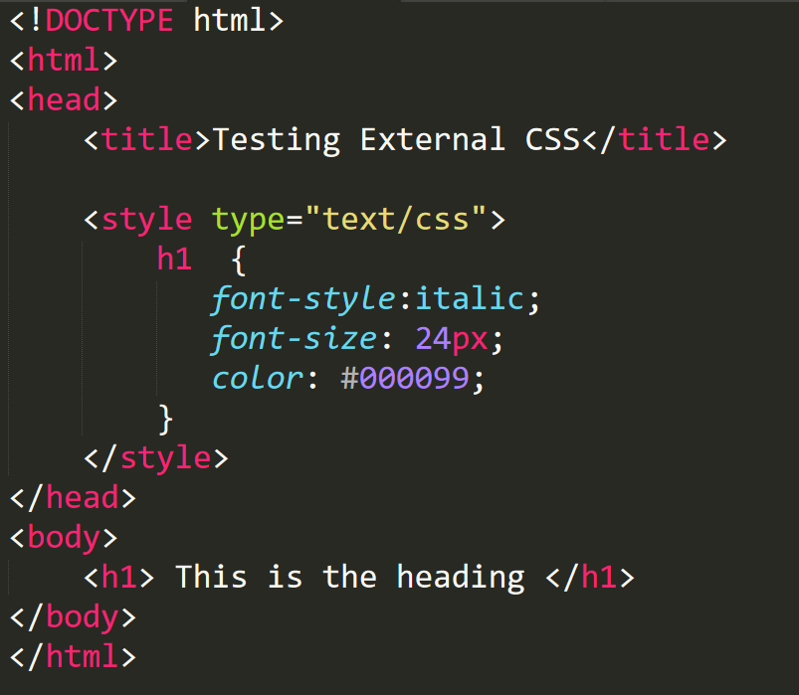
QUIZ:
Convert the following to an external css
Notes:
Participants may also use an existing internal stylesheet in an existing class exercise

Slide 46

WELDONE GUYS!
Everything is Achievable

